Slide 1

C PER
Center for Advanced Power Engineering Research
Reduction Model and Circuit Mapping with GIS
Presented By:
Joshua Smith, Undergraduate Research Assistant
Dr. Elham Makram, Faculty Advisor
Clemson University

Slide 2
Introduction
Feeder Reduction
Quasi-Static Time Series Analysis used to prove electrical equivalency of reduced feeder through comparison to historical data
Circuit Mapping with GIS
Program flow with example of mapped circuit
Future Work

Slide 3
Objectives
Determine probabilistic deployment of DER
Develop future planning criteria involving voltage regulator placement, capacitor placement, and wire sizing

Slide 4
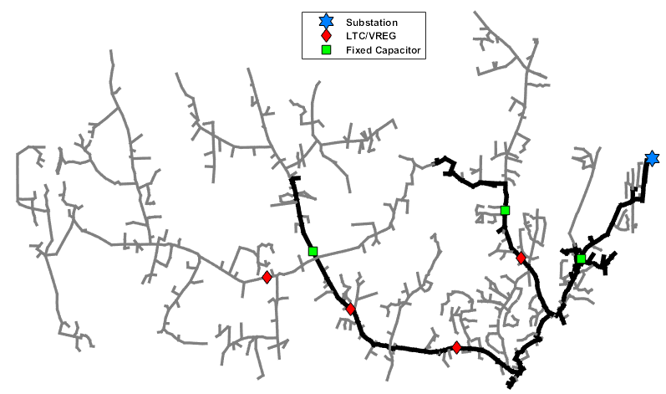
Feeder Reduction
Figure 1: Detailed Feeder Model

Slide 5
Feeder Reduction
OpenDSS (powerflow software by EPRI)
Voltage regulators, capacitors, etc. maintained
Lines reduced by change in conductor type/spacing
Loads represented as spot loads
Quasi-Static Time Series
Powerflow based on previous state

Slide 6
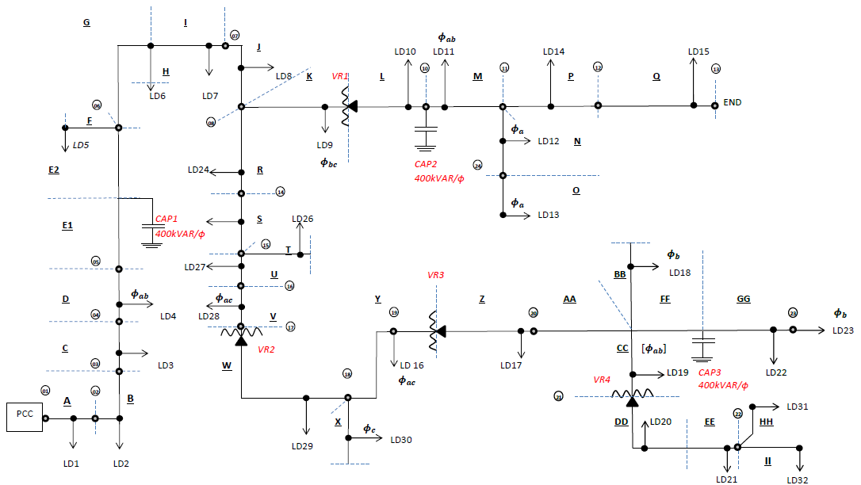
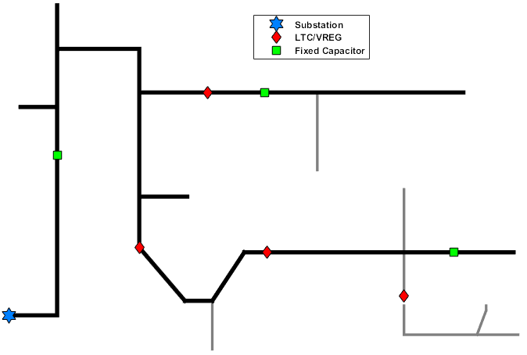
Feeder Reduction
Figure 2a: Simplified Feeder Planning
Figure 2b: Simplified Feeder Model

Slide 7
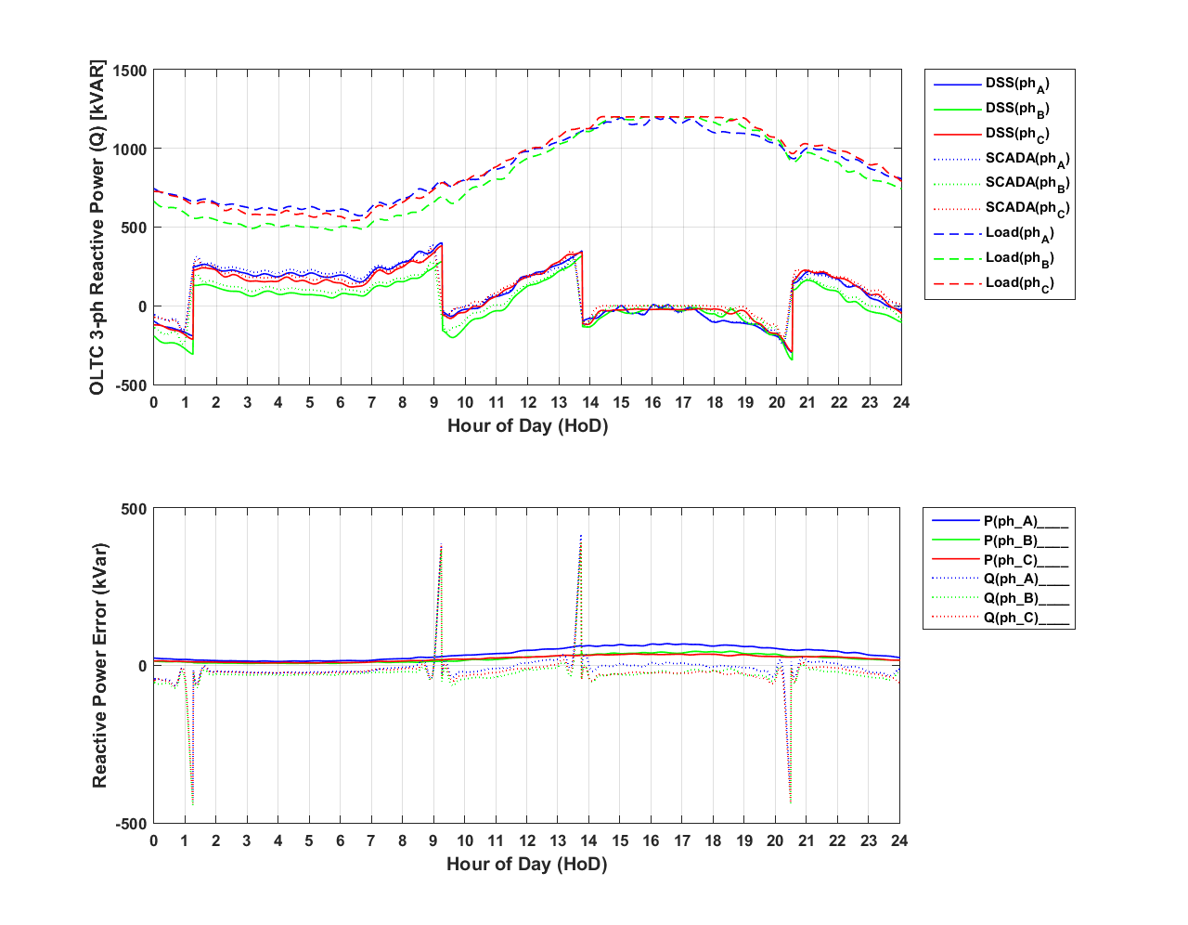
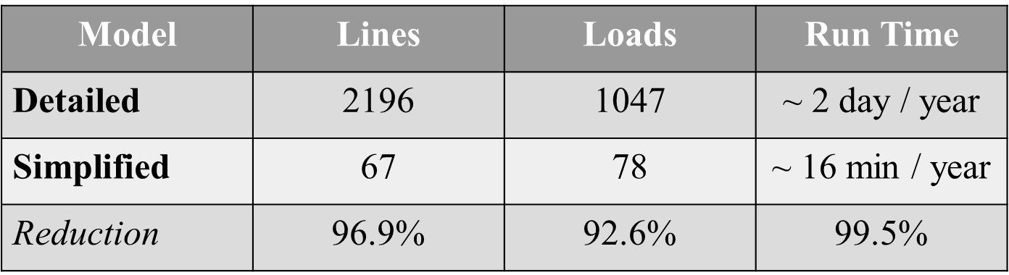
Feeder Reduction
Table 1: Reduction Percentages
Figure 3: 24 QSTS kVAR and Resulting Error

Slide 8
Circuit Mapping with ArcGIS
CYME
Shape File
OpenDSS
Coordinates
Determine DG Location on Feeder
Suitable PV Locations
ID
Bus1
Bus2
Lat
Long
Reduce?
YES
Reduce
NO
YES
Update?
Analysis
NO

Slide 9
Circuit Mapping with ArcGIS
CYME
Shape File
OpenDSS
Coordinates
Determine DG Location on Feeder
Suitable PV Locations
ID
Bus1
Bus2
Lat
Long
Reduce?
YES
Reduce
NO
YES
Update?
Analysis
NO

Slide 10
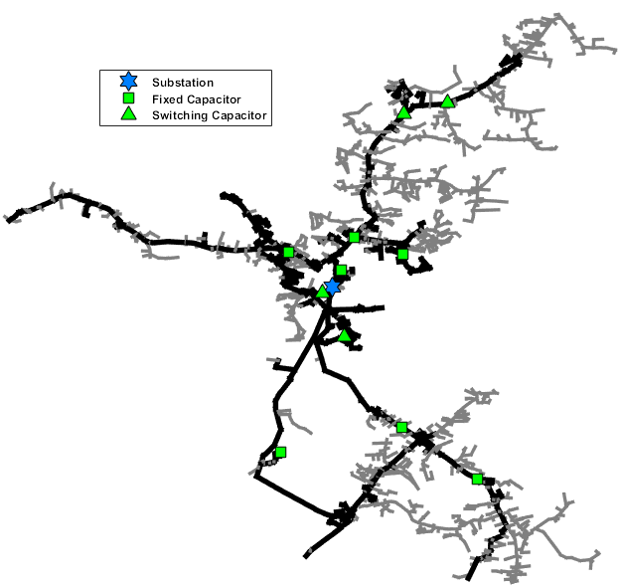
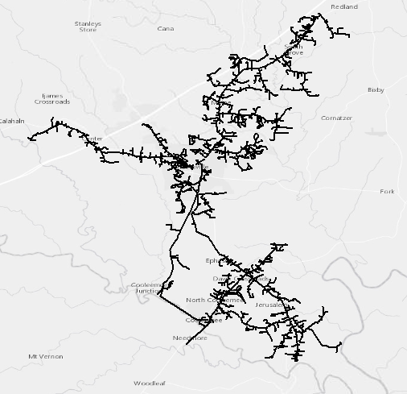
Circuit Mapping with ArcGIS
Figure 4a: MATLAB Feeder Plot
Figure 4b: ArcGIS Feeder Plot

Slide 11
Future - Circuit Mapping with ArcGIS
CYME
Shape File
OpenDSS
Coordinates
Determine DG Location on Feeder
Suitable PV Locations
ID
Bus1
Bus2
Lat
Long
Reduce?
YES
Reduce
NO
YES
Update?
Analysis
NO

Slide 12
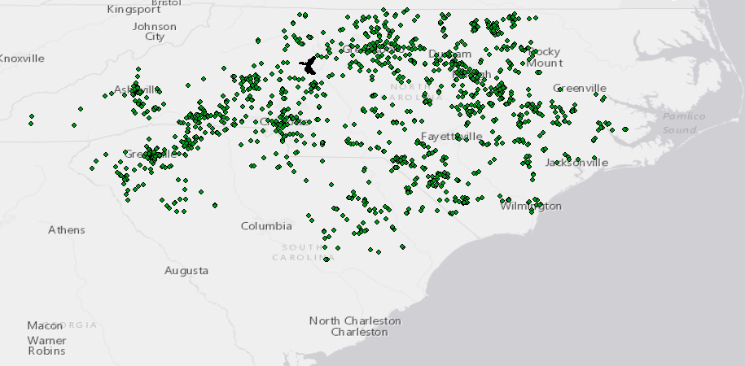
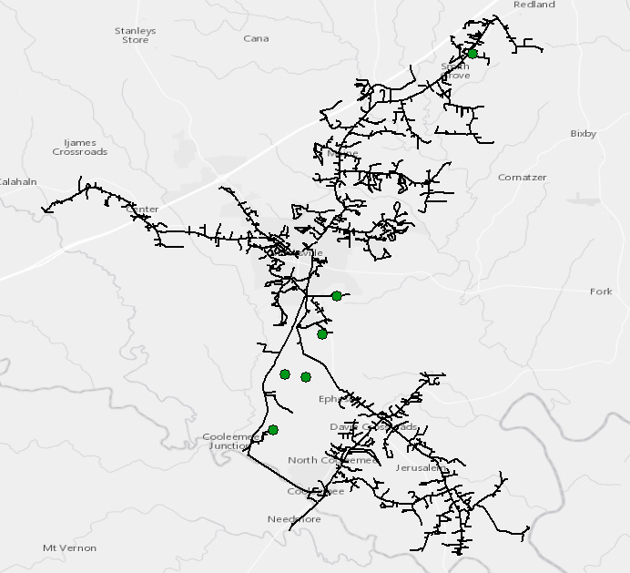
Future - Circuit Mapping with GIS
Figure 5: Circuit Plotted in ArcGIS with PV Requests

Slide 13
Future - Circuit Mapping with GIS
Feeder Lines
Intersection?
Increment PV Point Buffer
NO
YES
PV Request
Add Intersect
Temporary PV Delete
Return
NO
Unmatched PV?
YES

Slide 14
Future - Circuit Mapping with GIS
Feeder Lines
Distance from each request to every point on feeder
PV Request
Determine Minimum Distance
Add Intersect
Return
NO
Unmatched PV?
YES

Slide 15
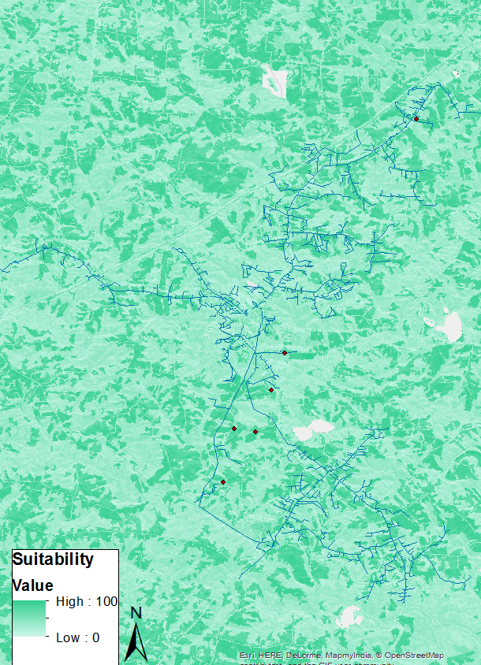
Future – Circuit Mapping with GIS
System Wide Analysis
Use size of current requests to approximate the land use
Based on land use, determine minimum land suitability necessary for a requests
Determine minimum stiffness ratio based on POI
Ability of system to resist voltage changes due to variability of DG
Use suitability and stiffness ratio to determine future DER POI

Slide 16
Conclusion
Automated feeder simplification is necessary to reduce the runtime
Adding current and predicted future DER to the OpenDSS model will provide better insight into necessary system upgrades
The simplified feeder can be used to test the effects of voltage regulator placement, capacitor placement, and wire sizing

Slide 17
Thanks！

